Slide 1

Introduction to Word Embedding

Slide 2
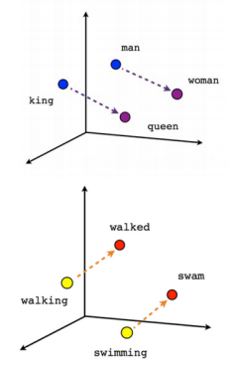
Learning Word Embedding
What is Word Embedding?
Learn representation for text where words that have the same meaning have similar representation.
What kind of representation?
Represent or Transform free text word into numeric values in dense dimension.
Why do we need Word Embedding?
Many Machine Learning algorithms and almost all Deep Learning Architectures are incapable of processing strings or plain text in their raw form
Traditional representation is impractical computationally when dealing with the entire vocabulary

Slide 3
Learning Word Embedding
Word representation
Frequency based model
Word embedding model
Count vector
TF-IDF vector
Co-occurrence vector
Word2Vec [Mikolov et al., 2013]
GloVe: Global Vectors [Penington et al., 2014]

Slide 4
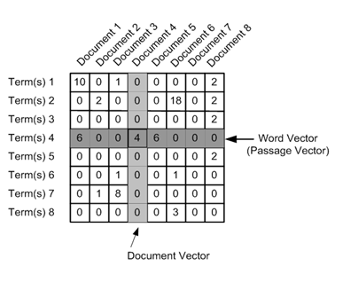
Count Vector
Create matrix with size N x D, where N is the number of unique tokens and D the number of Documents in corpus
The value of matrix is the frequency of each token in each document.
Example :
D1 : He is a lazy boy. She is also lazy.
D2 : John is a lazy person
 | D1 | D2
He | 1 | 0
lazy | 2 | 1
boy | 1 | 0
She | 1 | 0
John | 0 | 1
person | 0 | 1
https://www.analyticsvidhya.com/blog/2017/06/word-embeddings-count-word2veec/

Slide 5
TF-IDF vector
Similar with count vector, however the value inside the matrix is replaced by the result of TF-IDF
TF - IDF (Term Frequency – Inverse Document Frequency)

Slide 6
Co-Occurrence vector
Based on the assumption that “similar word tend to occur together in the same context”
Co-occurrence :
For a given corpus, the co-occurrence of a pair of words say w1 and w2 is the number of times they have appeared together in a Context Window.
Context Window :
The number of word around target word
Below is the example of context word with size 2

Slide 7
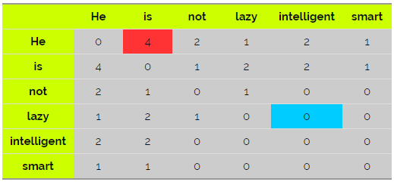
Co-Occurrence Vector (2)
Example :
He is not lazy. He is intelligent. He is smart

Slide 8
Word2Vec
Proposed by Mikolov et al 2013
What is Word2Vec?
Two layer neural network that process text (shallow network, not part of deep learning)
What we need: text corpus
What we get: a set of vector representation for each vocabulary
How it works: predict the probability of words against other words that neighbor them in the input corpus
Neighbor words similar to context

Slide 9
Word2Vec
Two methods in Word2Vec
Word2Vec
CBoW
(Continuous Bag of Word)
SG (Skip-Gram)

Slide 10
Continuous Bag of Words (CBoW)
CBoW predict target word giving context words as an input
Architecture of CBoW is fully connected NN consist of 3 layers:
Input Layer
Context words that represent as one hot vector
The size (the number of neurons) same as the number of vocabulary in corpus
Hidden layer
The size is set to the number of dimension of word embedding (50-300)
Output Layer
Target word that also represent as one hot vector
The size is similar to the input size

Slide 11
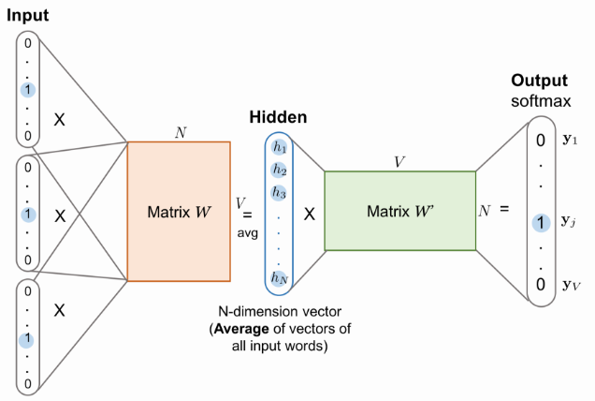
Continuous Bag of Words (CBoW)
Matrix W (weight connection input-hidden)
Embedding vector, size V x N
V is the number of vocabularies
N is the dimension of word embedding
Matrix W’ (weight connection hidden-output)
Size N x V

Slide 12
Continuous Bag of Words (CBoW)
One hot vector means in a vector only one value that set to 1 an the rest is set to 0
Example:
He is lazy man, but He is smart
The representation of word “He”
The representation of word “lazy”
but | He | is | lazy | man | smart
0 | 1 | 0 | 0 | 0 | 0
but | He | is | lazy | man | smart
0 | 0 | 0 | 1 | 0 | 0

Slide 13
Continuous Bag of Words (CBoW)
Initialization
Forward step
Backward step
Step by step
Number of embedding dimension
Randomize value in matrix W and W’
Count the probability of target word given context words
Back-propagation step
Update matrix W and W’ based on the objective function

Slide 14


Continuous Bag of Words (CBoW)
The objective function of CBoW is to minimize the probability of target word $w_{t}$ given context words

Slide 15
Continuous Bag of Words (CBoW)
Example
He is lazy man.
(input, output) = {(is, lazy), (man, lazy)}
Input: {(0100)^{t}, (0010)^{t}}
Output: {(0001)^{t}, (0010)^{t}}
Initialization: N = 2; W has size 4 x 2; W’ has size 2 x 4
He | is | lazy | man
0 | 0 | 0 | 0

Slide 16

Continuous Bag of Words (CBoW)
Softmax function
Forward step
0
1
0
0
0
0
1
0
0.20 | 0.10
0.10 | 0.13
0.01 | 0.20
0.20 | 0.05
0.10
0.13
0.10 | 0.20 | 0.05 | 0.02
0.01 | 0.15 | 0.10 | 0.20
Backward step

Slide 17
Skip-Gram (SG)
SG predict context words giving target word as an input
Architecture of SG is fully connected NN consist of 3 layers:
Input Layer
Target words that represent as one hot vector
The size (the number of neurons) same as the number of vocabulary in corpus
Hidden layer
The size is set to the number of dimension of word embedding (50-300)
Output Layer
Context words that also represent as one hot vector
The size is similar to the input size

Slide 18
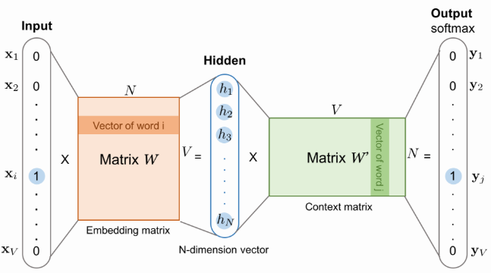
Skip-Gram (SG)

Slide 19



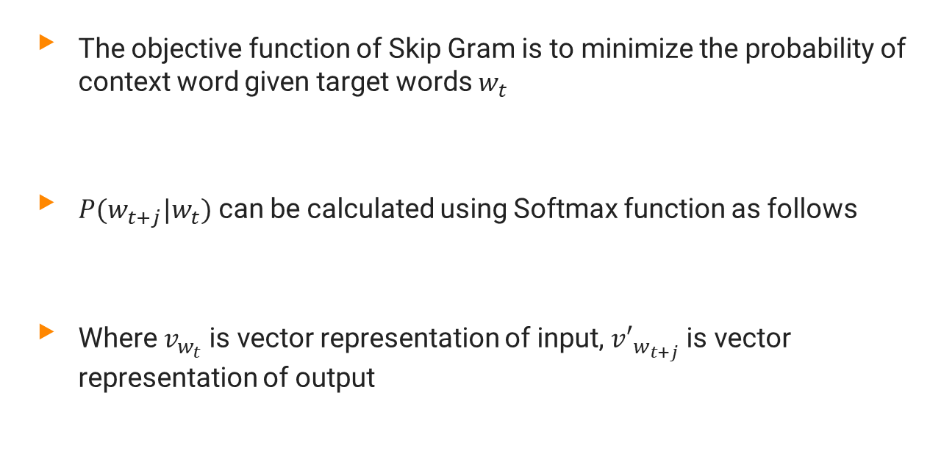
Skip-Gram (SG)
The objective function of Skip Gram is to minimize the probability of context word given target words $w_{t}$
$P(w_{t+j}|w_{t})$ can be calculated using Softmax function as follows
Where $v_{w_{t}}$ is vector representation of input, ${v′}_{w_{t+j}}$ is vector representation of output

Slide 20
Global Vectors (GloVe)
GloVe learn word vector representation by examining word co-occurrences within a text corpus.
Construct matrix co-occurrence
Define soft constrain
Define cost function

Slide 21



Global Vectors (GloVe)
Construct co-occurrence matrix $X_{ }$ using the fix context window where $X_{ij}$ represent the co-occurrence between word $i$ and word $j$
Define soft constrain for word vector as
$\vec{w_{i}}$ : vector of word i
$\vec{w_{j}}$ : vector of word j
$b_{i}$: bias of word i
$b_{j}$: bias of word j

Slide 22


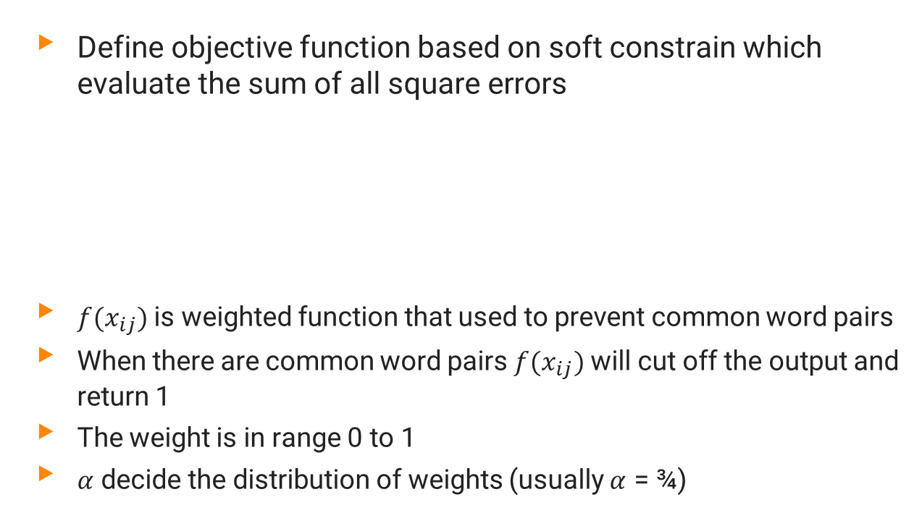
Global Vectors (GloVe)
Define objective function based on soft constrain which evaluate the sum of all square errors
${f(x}_{ij})$ is weighted function that used to prevent common word pairs
When there are common word pairs ${f(x}_{ij})$ will cut off the output and return 1
The weight is in range 0 to 1
$α$ decide the distribution of weights (usually $α$ = ¾)

Slide 23

Global Vectors (GloVe)
The training process will learn 4 variable $\vec{w_{i}}$, $\vec{w_{j}}$, $b_{i}$ and $b_{j}$
For updating the 4 variable we can use SGD (Stochastic Gradient Distance), AdaGrad, etc

Slide 24
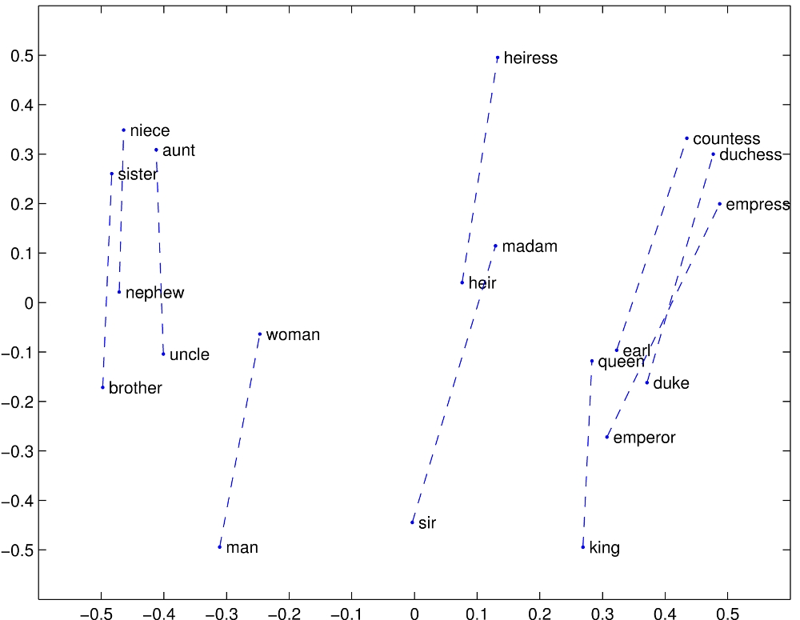
Example Result
Example the result of GloVe

Slide 25
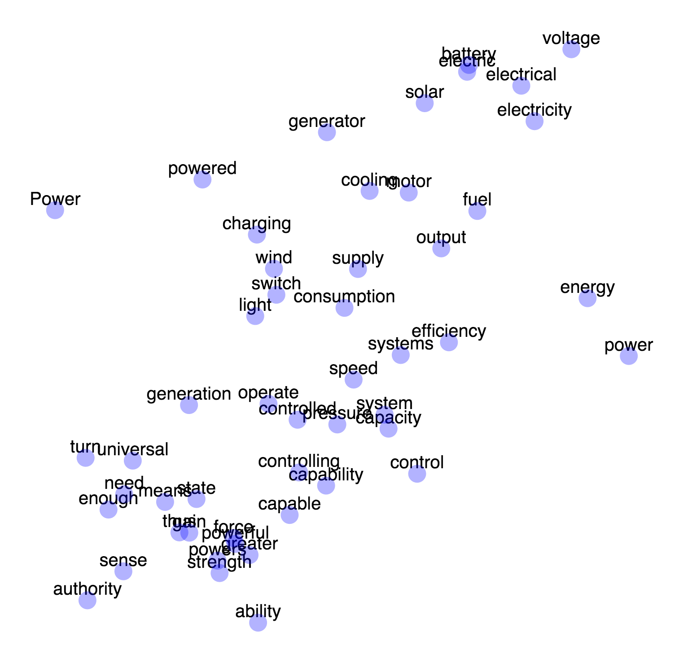
Example Result
Example result of Word2Vec

